Slide 1
HIS103: Emergence of Bangladesh
Mujibnagar Government and the War of Liberation
April 10, 2022

Slide 2
Mujibnagar Government
Background:
Mujibnagar , formerly known as Baidyanathtala is a suburb in the Meherpur district in Bangladesh.
Mujibnagar is a common reference for the government in exile formed to lead the War of Liberation in 1971.
In order to administer the liberation war efficiently, the first provisional government of Bangladesh was formed on April 10, 1971.
The formal swearing in ceremony was held on April 17, 1971 at Baidyanathtala, Meherpur which was attended by a large number of local and foreign journalists and other dignitaries.
Dr. Tawfiq-e-Elahi Chowdhury BB, the Sub-Divisional officer (SDO) of the then Meherpur Sub-Division, under Kushtia district played the most critical role in organizing the Mujibnagar Ceremony: "Milestone of our national history“ giving "life and legitimacy" to the national liberation movement both internally and internationally.
Mr. Mahbubuddin Ahmed, BB, then Sub-Division Police officer of Jhenaidah (SDPO) led the guard of honour given to the members of the Mujibnagar Cabinet on that auspicious day.
This government was headed by Bangabandhu Sheikh Mujibur Rahman, and the government is popularly termed as the “Mujibnagar government.”

Slide 3
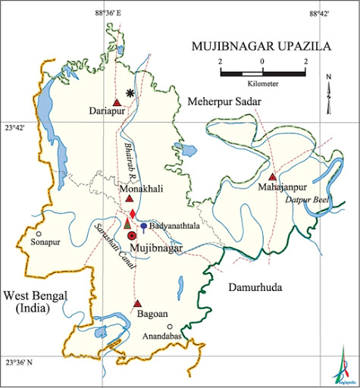
Map of Mujibnagar

Slide 4
Mujibnagar Government
Organization:
The government in exile at Mujibnagar had an elaborate structure of administrative departments and agencies.
The main function of the government included coordinating guerilla insurgency and bolster popular support in East Pakistan through organizational efforts, media and propaganda.
The organization of the government was as follows:
Bangabandhu Sheikh Mujibur Rahman: President
Syed Nazrul Islam: Vice-president/ Acting President

Slide 5
Mujibnagar Government
Organization (cont.):
Tajuddin Ahmed: Prime Minister (In charge of Defence, Information, Broadcasting and Communications, Economic Affairs, Planning Division, Education, Local Government, Health, Labour, Social Welfare, Establishment as well as other affairs the responsibility of which was not yet entrusted to any one)
Khandakar Mustaq Ahmed: Foreign Minister, Law and Parliamentary Affairs Minister
Captain (Rtd.) Mansur Ali : Finance, Industry and Commerce Minister:
A H M Quamaruzzaman: Minister, Ministry of Home, Civil Supplies, Relief and Rehabilitation, Agriculture
Colonel (Rtd.) M A G Osmani: Commander-in-Chief

Slide 6
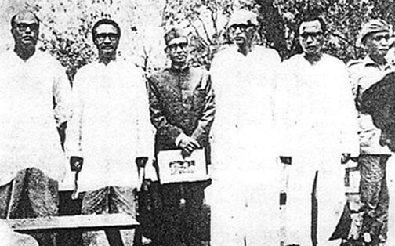
Vice President, Prime Minister, Ministers and Commander-in-Chief (Incharge) of Mujibnagar Government

Slide 7
Mujibnagar Government
Organizing the War of Liberation:
The Mujibnagar government guided the formation of the Mukti Bahini, Mijib Bahini (BLF-Bengal Liberation Force) and some others forces.
Bangabandhu was declared the Supreme Commander of the War of Liberation.
The Ministry of Defence divided the war zone into eleven sectors and appointed a sector commander for each of the sectors.
There was no sector commander for sector No 10 or naval sector.
Commandos used to fight under the command of the concerned sector commander whenever and wherever they carried out the operation in a particular sector.
Besides, there were three brigades called Z force, K force and S force. Major Ziaur Rahman, Major Khaled Mosharraf and Major K. M. Shafiullah were the commanders of the brigades respectively.

Slide 8
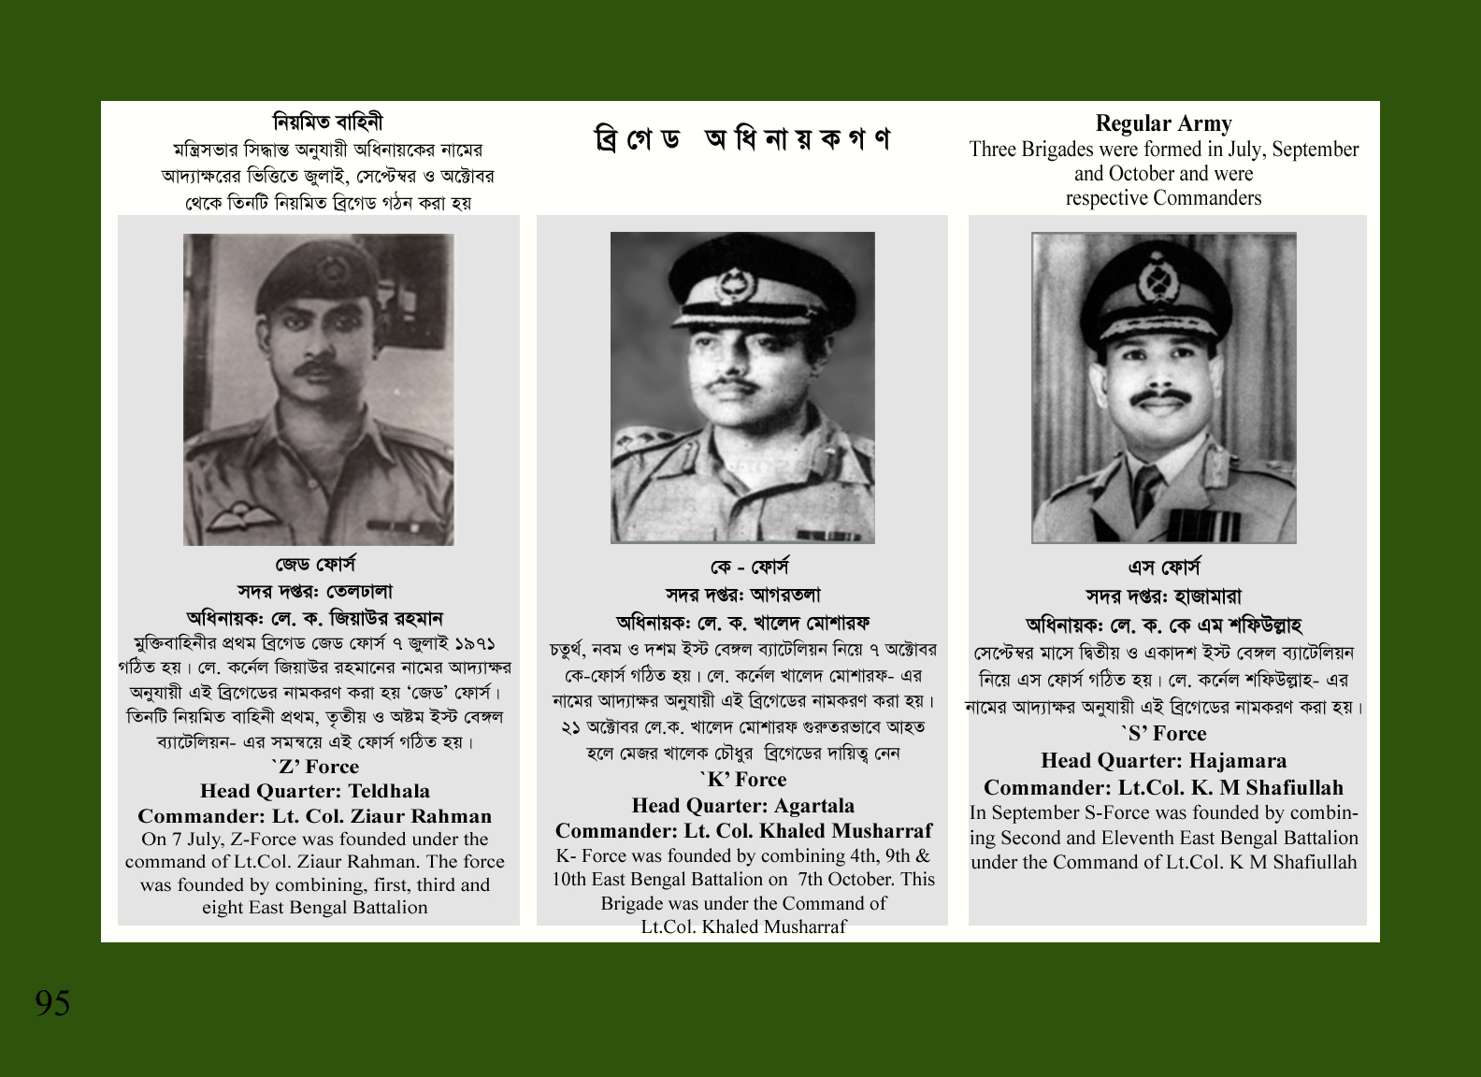
‘Z’ Force, ‘K’ Force & ‘S’ Force

Slide 9
Mujibnagar Government
The formation of the Mujibnagar government and its pronouncement to the world at large on April 17, 1971 is really a red-letter event in our national history, specially after the thumping victory of the Awami League in the elections of 1970 under the leadership of Bangabandhu Sheikh Mujibur Rahman.
The 167 MNAs and 298 MPs who composed the Constituent Assembly fulfilling their constitutional obligation to the electors, gave a true shape and constitutional perspective on this day, making the dream of an independent Bangladesh a reality. From this point of view, Mujibnagar day (April 17) is a landmark in our struggle for independence as well as in our national history.

Slide 10
Mujibnagar Government
The Mujibnagar government established Missions (Embassies) of Bangladesh in many important cities around the world like Calcutta, Delhi, London, Washington, New York, Tokyo and Stockholm. These Missions tried to run campaigns in favor of Bangladesh and earned support for the government of Bangladesh.
It also appointed Justice Aby Sayeed Chowdhury as the special envoy of the Provisional Government to mobilize world-support in favor of the liberation war.
The Mujibnagar government is considered as the first official government of Bangladesh.

Slide 11
Mujibnagar Government
Herculean task done by the Mujibnagar Government:
Organizing civil administration and the freedom fighters, securing arms for the latter and training them, mobilizing international support for the liberation war through intense diplomatic action, ensuring speedy communication and effective coordination of various activities at hundred different levels, above all, keeping the morale of the freedom fighters high throughout the dark, difficult, and strenuous days of the war, called for extraordinary wisdom, dedication, patience, foresight, courage, and tenacity on the part of the Mujibnagar government and all those connected with it.
The formation of the Mujibnagar government had great significance for the fact that the great men who gave leadership to this great event in the absence of our supreme leader and continued the armed struggle for the following eight months, having allowed no breach in the unity of their people, which was one of the cornerstones of our total liberation war, fought valiantly involving everyone, and above all kept our leader alive in the minds of every freedom fighters as if he was fighting side by side with them.
N:B: (Available at: http://www.albd.org/articles/news/31116/Mujibnagar-Government:-First-Milestone-of-'Bangladesh‘. Accessed on April 12, 2020)

Slide 12
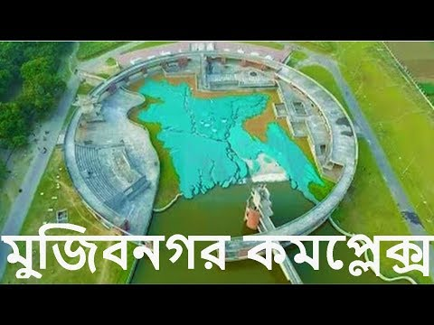
Mujibnagar Complex

